Slide 1
Reading Time Go over paper and review Discussion starts at 1:15
https://teach2impact.com/2020/07/19/the-story-of-normal-distribution-of-grades/

Slide 2
A Fresh Look at Novice Programmers’ Performance and Their Teachers’ Expectations
Utting et al. (2013)
https://dl.acm.org/doi/10.1145/2543882.2543884
All information from paper listed above unless otherwise cited

Slide 3
Definitions
ITiCSE (Innovation and Technology in Computer Science Education) working group convened in 2013
ITiCSE 2001 McCracken working group
CS1- first programming course
-programming focus

Slide 4
Definitions
Foundational CS1 (FCS1) Assessment Instrument
validated exam designed to measure students' conceptual understanding of programming concepts.
written in a pseudo-code format
consists of multiple-choice questions including definitions, tracing code execution, and completing missing code segments

Slide 5
Definitions
Scaffolding - instructional support or guidance provided to students during the learning process.
In the study, scaffolding was provided to students in the form of skeleton code, a test harness, and other supports that aided them in implementing the programming task.

Slide 6
Definitions
ECTS - ECTS credit is a broad measure of student effort, including formal teaching and self-study time.
- 1 ECTS credit is equivalent to 25-30 hours of student effort

Slide 7
Motivation
whether “students in 2013 are any more likely to fulfill teachers expectations than they were in 2001”?

Slide 8
Two-part assessment.
skill and concept assessments
concept assessment -The Foundational CS1 Assessment Instrument
programming skill assessment -The clock problem

Slide 9
The concept assessment
Has 27 multiple-choice questions
From concept areas: Fundamentals, Logical Operators, Selection, Definite Loops, Indefinite Loops, Arrays, Function/Method Parameters, Function/Method Return Values and Recursion
scored in two ways( Complete Score & Subset Score)

Slide 10
The skill assessment
The clock problem
- scored with a test harness.
-The harness contained a set of black box tests that validated the functionality of the student’s programs

Slide 11
The clock task
Class (called Time) representing a 24-hour clock
The clock has four operations :
- a tick operation
-a comparison operation
-add and
-subtract methods.

Slide 12
Cohort
Consists of 418 first-year students
taken at least one introductory programming course
The amount of programming education for the cohort varied between 4 and 10 ECTS with a weighted average of 7 ECTS.

Slide 13
Eight groups of the Cohort
The cohort represents students from 12 institutions in 10 countries.
-18% of the cohort is from the USA,
- 82% is from Europe.
-Approximately 50% of the total cohort is from a single European university.
we divided the cohort into eight groups.

Slide 14
The groups vary in many ways, e.g.:
Amount and type of programming education prior to data collection
Amount of additional non-programming CS education
Program of study (CS major, CS minor, Engineering, CS/programming as an elective, etc.)
Type(s) of programming language(s) used
Language of instruction (native/foreign)

Slide 15
Overview of Cohort.

Slide 16
Task Administration
Students undertook the task in “closed lab” settings of around 90 minutes duration (group S had 75 minutes, and group U 110)
In three cases (R1, R2 and P) the students were volunteers comprising 10-30% of their respective cohorts. Most of the participants were mildly incentivized to participate.

Slide 17
Test Harness
Test harness consisted 8-10 black-box tests for each of the four methods
The test harness was organized so that all the tests for a particular method were performed, independent of any failures, but tests for subsequent methods were only executed if all prior tests had passed.
had the effect of “ordering” students’ approach to the tasks
The order of method tests in the reference test harness was: tick(), compareTo(), add(), and subtract().

Slide 18
Task: Analysis & Results
The overall mark is an integer between 0 and 4
– a count of how many of the methods in a submission passed all the tests.

Slide 20
Cohorts with a Test harness

Slide 21
Cohorts without a Test harness

Slide 22
Partial success for the non-harness groups

Slide 23
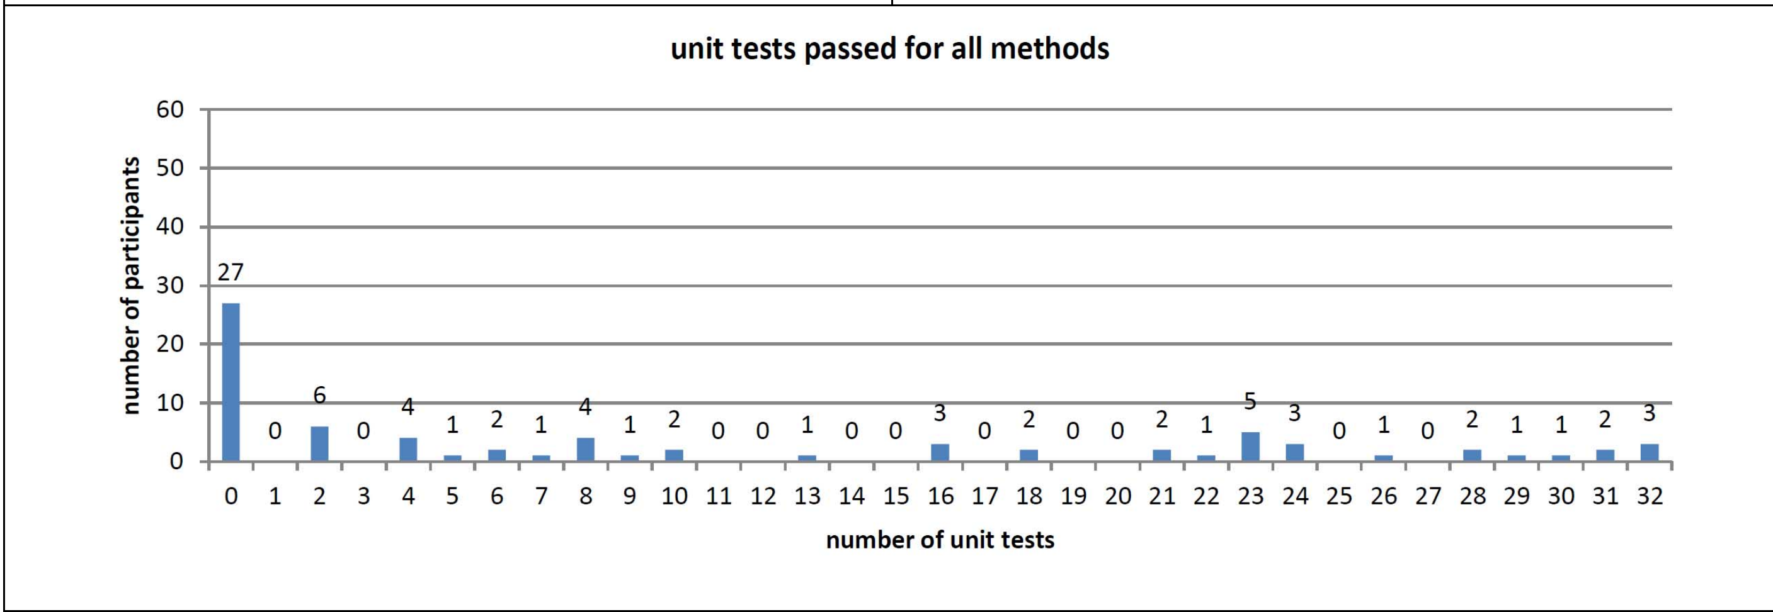

Slide 24
The Assessment instrument
Overall Student Scores on the FCS1 Assessment Instrument by Cohort

Slide 26
Overall Task Score and Concept Assessment

Slide 27
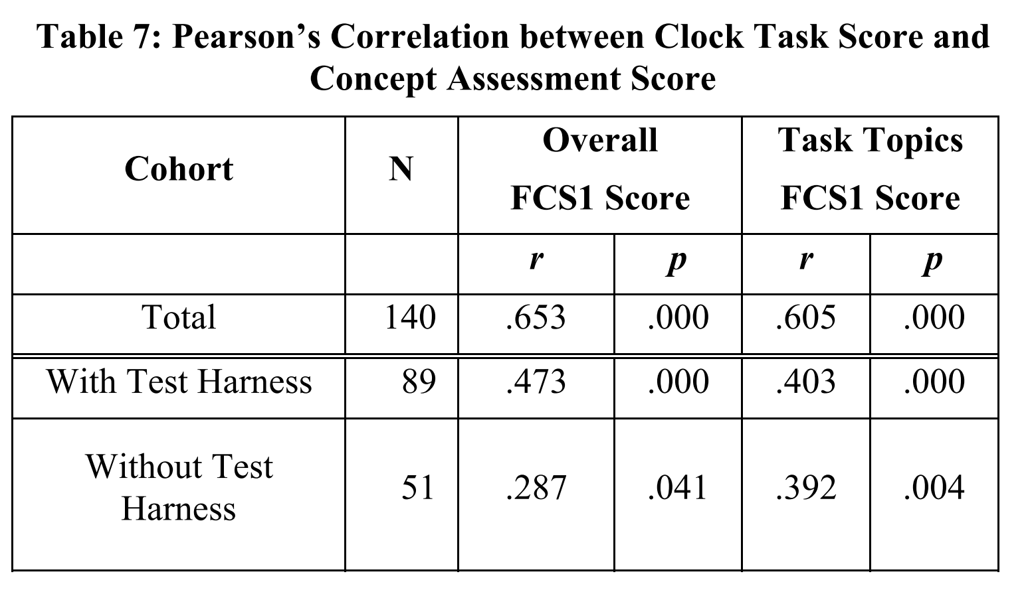

Slide 29
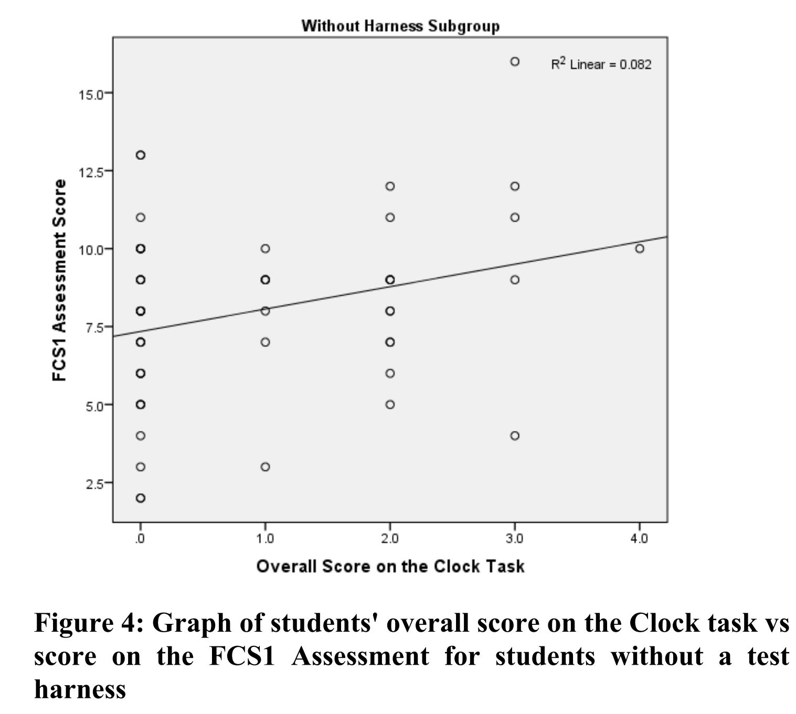

Slide 30
Teachers’expectations

Slide 33
COMPARISON WITH THE ORIGINAL MCCRACKEN WORKING GROUP AND OTHER STUDIES
Original McCracken Working Group (MWG) study conducted a multi-national, multi-institutional experiment on calculator exercises. The average General Evaluation (GE) score was 22.9 out of 110, indicating a gap between student skill level and instructor expectations.
Sweden Group (SG) study built upon the MWG study and provided the infix calculator problem to 40 students at one institution. The GE score average was 68.2 out of 110, suggesting improved performance when confounding issues were eliminated.

Slide 34
Current study shares similar goals with MWG but uses different assessment instruments and a larger cohort. The clock problem was chosen, which is more aligned with object-oriented environments and less algorithmically complex.
SG study provided scaffolding with a skeleton calculator and I/O code, while the current study offered an explicit skeleton Time class and a testing framework for students.
Results show that instructor expectations are more accurate now compared to the MWG era. Performance is better when students are not required to design a whole application and can easily verify their results, aligning more closely with the SG study.

Slide 35
Changes in Teaching, Assessment, and Students
Changes in Teaching and Assessment:
-Evolution from CC2001 to CS2013, Increase in "CS0" courses enhancing introductory CS courses.
-Growing diversity in platforms and programming languages used.
-Adoption of software engineering innovations like test-driven development and version control.
Changes in Students:
-Prior exposure to computers, software, online resources dependency on technology for learning.
-Expectation of "always on" access to the Internet during coding.
-Use of online resources, such as API documentation, programming forums, and social media for support.

Slide 36
summary
Students in this working group performed better than in the original MWG study.
Two distinct populations with high and low average completion rates were observed within the cohort.
Factors contributing to the performance difference include prior programming education and the availability of a test harness.
The test harness served as scaffolding, providing guidance and continuous feedback to students.
Students with the test harness had less work, lower mental load, and a clearer implementation path.

Slide 37
summary
Sequencing learning activities in increasing order of difficulty helped manage students' cognitive load.
Writing tests posed challenges for some students, requiring understanding beyond the task itself.
Teachers' expectations in this study were more aligned with student performance compared to the original MWG.
Teacher familiarity with previous studies may have influenced their expectations.
The original MWG study may have had a lasting effect on teachers' expectations of students' abilities.

