Slide 1
Artificial Intelligence

Slide 2
What is Intelligence?
Notes:
Reasoning, problem solving
Construct knowledge
Planing
Learning
Perception

Slide 3
What is Artificial Intelligence?

Slide 4
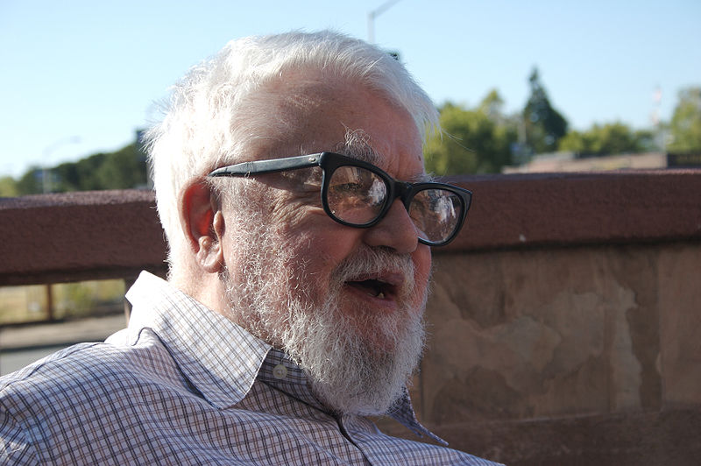
John McCarthy
(1927 - 2011)
Image Source: Wikipedia
Notes:
The birth of the field of AI comes from the work of this man, John McCarthy. In 1956, John McCarthy of Dartmouth College (who later created the Lisp programming language) helped organize a conference to discuss Artificial Intelligence

Slide 5
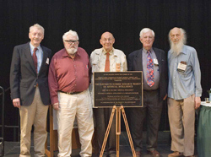
Dartmouth Summer Research Project on Artificial Intelligence - 1956
McCarthy himself, Allen Newell, Herbert Simon, Claude Shannon, and Marvin Minsky
Groundwork for AI were first introduced
Image Source: Dartmouth
Notes:
During that summer, several leading minds in the world of AI gathered together for what was essentially a several week long brainstorming session.
Attendees included McCarthy himself, Allen Newell, Herbert Simon, Claude Shannon, and Marvin Minsky, as well as many others.
Pictured here are some of the surviving members of the conference celebrating the 50th anniversary in 2006.
At this conference, much of the groundwork and ideas in Artificial Intelligence were first introduced, and it helped shape the field for many years to come.

Slide 6
What is Artificial Intelligence?
"It is the science and engineering of making intelligent machines, especially intelligent computer programs. It is related to the similar task of using computers to understand human intelligence, but AI does not have to confine itself to methods that are biologically observable."
- John McCarthy, 2007

Slide 7
Yes, but what is intelligence?
"Intelligence is the computational part of the ability to achieve goals in the world. Varying kinds and degrees of intelligence occur in people, many animals and some machines."
- John McCarthy, 2007

Slide 8
Isn't there a solid definition of intelligence that doesn't depend on relating it to human intelligence?
"Not yet. The problem is that we cannot yet characterize in general what kinds of computational procedures we want to call intelligent. We understand some of the mechanisms of intelligence and not others."
- John McCarthy, 2007

Slide 9
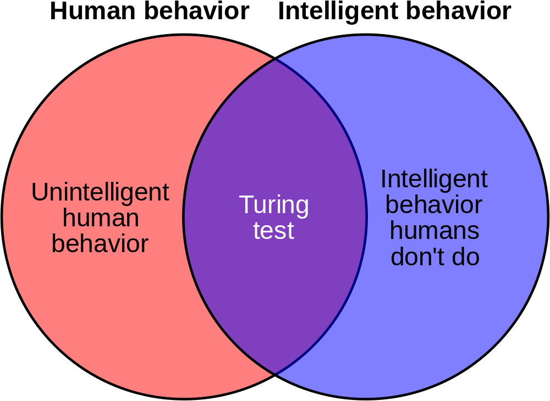
Image Source
Notes:
One problem with AI is that it forces the computer to mimic all human behavior, not just intelligence.
Things such as slow response times, typos, and commonly held misconceptions that aren’t true are all examples of human behavior that might not be considered intelligent, but it is still something a successful AI agent must possess to pass the test.
Likewise, it must also act as if it cannot solve some problems that are perfectly within its abilities, simply because those problems are unsolvable by a human’s intelligence.

Slide 10
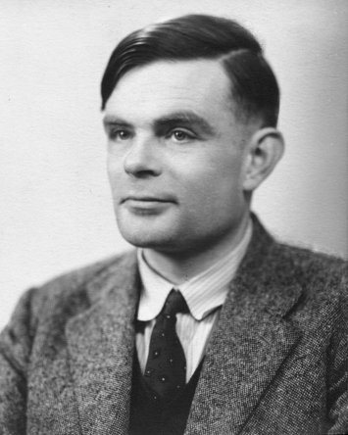
Alan Turing (1912 - 1954)
"I propose to consider the question, ‘Can machines think?’”
- Turing, 1950
Image Source: Wikipedia
Notes:
That was the problem that Alan Turing ran into.
He was deeply interested in the field, but unfortunately there was no good way to determine if a system was truly “intelligent” at the time.
In 1950, he wrote a paper called “Computing Machinery and Intelligence” which he opened with the following statement: “I propose to consider the question, ‘Can machines think?’”
In that paper, he describes one way to test a machine’s intelligence, which is now known as a Turing Test

Slide 11
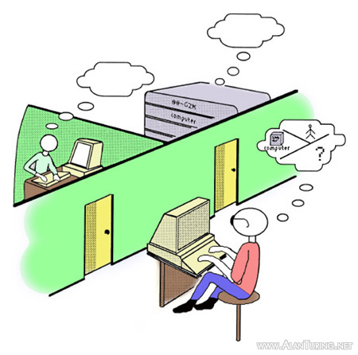
Turing Test
Image Source: Rutherford Journal
Notes:
The basic idea of a turing test is as follows: you have a person in a room with a computer capable of text-based chat.
In another room is either a computer or a human that responds via the text-based chat system.
The computer will try to pass itself off as a human being, by responding to the prompts from the tester.
The tester then must determine if he or she was conversing with a computer or a real person. So far in history, no computer has completely passed the Turing test, but many have come very close at times.
So, now that we’ve seen the turing test, can anyone think of some problems it may have?

Slide 12
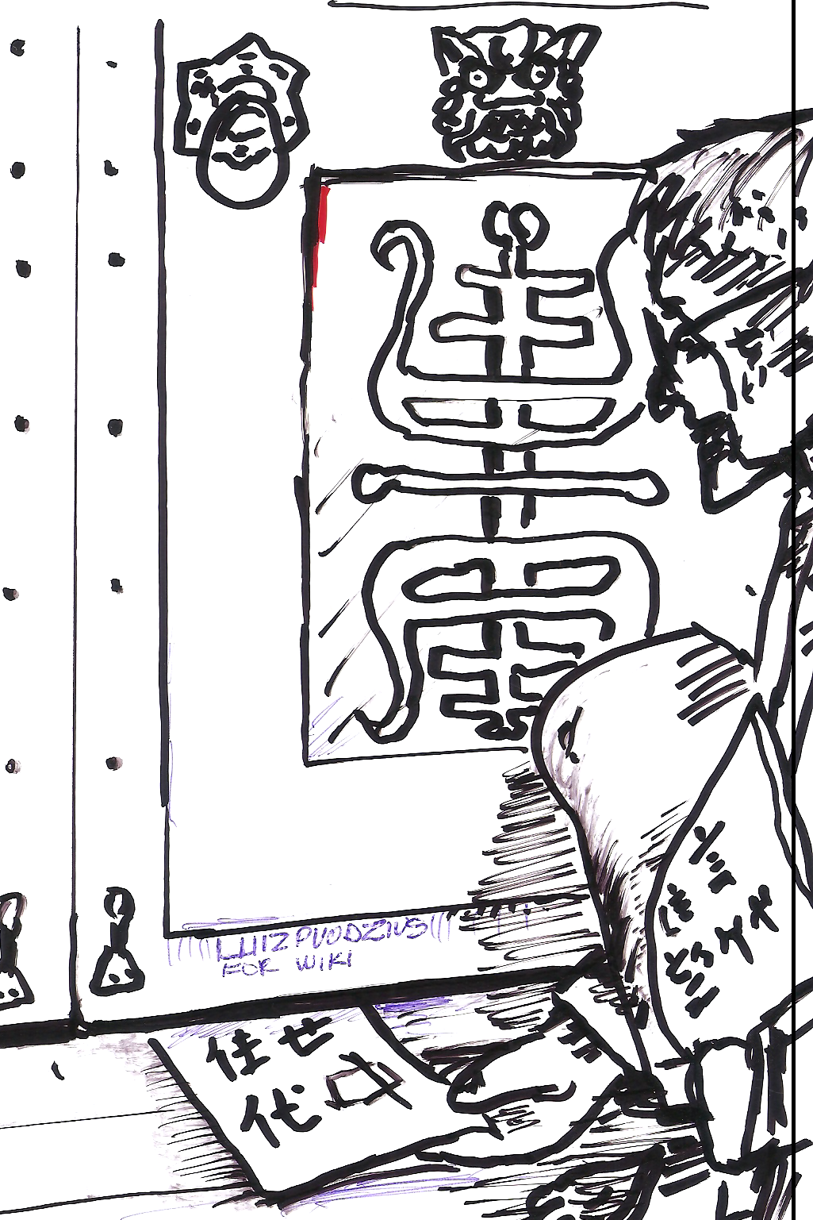
Chinese Room
John Searle 1980: “Minds, Brains, and Programs”
Instructions for input/out of Chinese characters
Intelligent, or just good at following directions?
Image Source: Wikipedia
Notes:
Another problem with the Turing Test is highlighted in the Chinese Room thought experiment, as proposed by John Searle in 1980 in his paper “Minds, Brains, and Programs.”
In this setup, an English speaking person is placed in a room with sufficient supplies and a set of instructions completely written in English that directs him to accept Chinese language characters as input, and output a response of Chinese characters.
On the other side of the wall is a native Chinese speaker performing a “Turing Test,” and in this case that person is convinced that the person on the other side of the wall is indeed a human.
However, the computer, being a human that only speaks English, is blissfully unaware of the conversation taking place in Chinese.
So, is the machine “intelligent” or merely so advanced at following instructions as to appear “intelligent?”

Slide 13
Strong AI vs. Weak AI
Strong AI - matches human intelligence and is capable of performing any task
Weak AI - only designed to perform a specific subset of intelligent actions
Notes:
This leads to the endless debate between Strong AI and Weak AI. When you think of AI in movies, this is usually “Strong AI” which is designed to completely mimic or surpass human intelligence.
Unfortunately, at this time Strong AI is not a reality, and some debate that it is even possible.
Most of the AI that we deal with today is a form of Weak AI, also called Narrow AI, which is designed to perform only a subset of intelligent actions.

Slide 14
Intelligent Agents
Agent: Definition Any entity that perceives its environment through sensors and acts upon that environment through effectors
Examples (class discussion): human, robotic, software agents
Notes:
Much of AI today works with the concept of “Intelligent Agents.” They are entities that can perceive things about its environment through sensors and then act upon that environment with effectors, hopefully in a way that can be perceived. So, what do you think are some examples of intelligent agents that you’ve seen in your lives recently?
Each agent has 4 major functions:
Perception - what it can sense (not everything)
Sensors - what it can understand (only what it senses and knows about)
Action - what it can do (only knows a subset of all possible actions)
Effectors - how it can do things (may not be capable of doing enough)

Slide 15
How Agents Should Act
A rational agent:
  Does the right thing
  Given what it believes
  From what is perceives
Maximum Success Measure (Utility)
  What is the right thing
  How and When to evaluate success
Notes:
A rational agent, which is what we would perceive as intelligent, is concerned with doing the right thing, given what it believes, from what it perceives.
As you can guess, it may not know everything, but it will try to do the best thing it can.
We can also measure the utility of an agent by measuring its maximum success.
That is, what IS the right thing, and how do we figure out how well it did that thing.
So, to understand the effectiveness of artificial agents, we have to ask ourselves questions about our beliefs, the uncertainty of knowledge, and how it is represented and how we can reason or learn from it.
By studying our own rational behaviors and why we as humans do the things we do, we can hopefully better understand what goes into a decision making process and how we can build better rational agents.

Slide 16
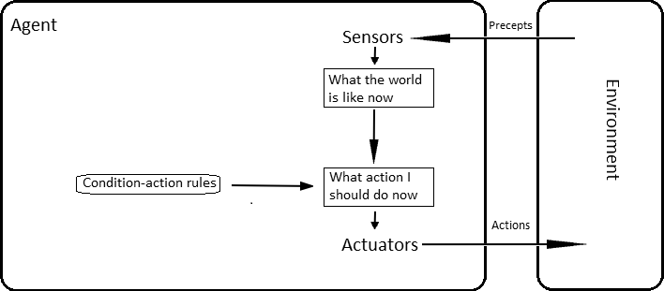
Simple Reflex Agents

Slide 17
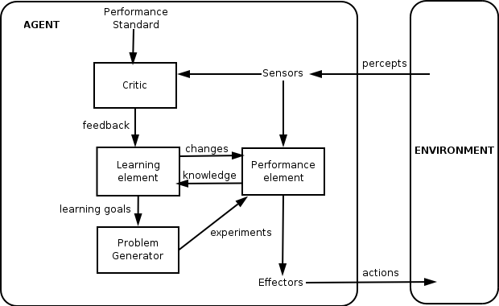
Learning Agents

Slide 18
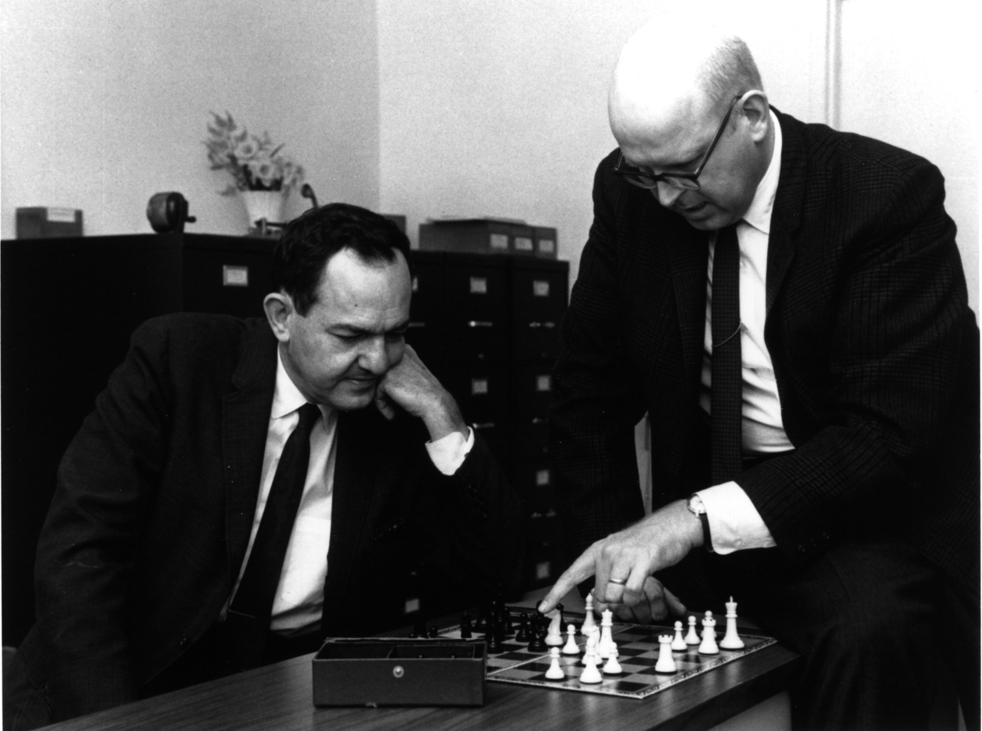
Logic Theorist
Allen Newell, Herbert Simon
Wrote a program with problem solving skills in 1955
Used to prove theorems
Image Source: Wikipedia
Notes:
One early attempt at Artificial Intelligence comes to use from these two men, Allen Newell and Herbert Simon.
In 1955, they wrote a program designed to mimic the problem solving skills of a human being, and called it the “Logic Theorist.”
This program is now widely considered to be the first AI program.
It was used to prove theorems in the book Principia Mathematica, and actually created a much more elegant proof for some theorems than those included in the book, much to the delight of the book’s authors as well as Newell and Simon.
At the time, interest was swirling in the growing idea of AI, and the experts decided to come together and discuss the topic at length.

Slide 19
Methods for Developing AI
Knowledge Representation
Search
Expert Systems & Knowledge Bases
Planning: classical, universal
Probabilistic reasoning
Machine learning: neural networks, evolutionary computing
Applied AI: agents focus
Special topics (NLP focus)

Slide 20
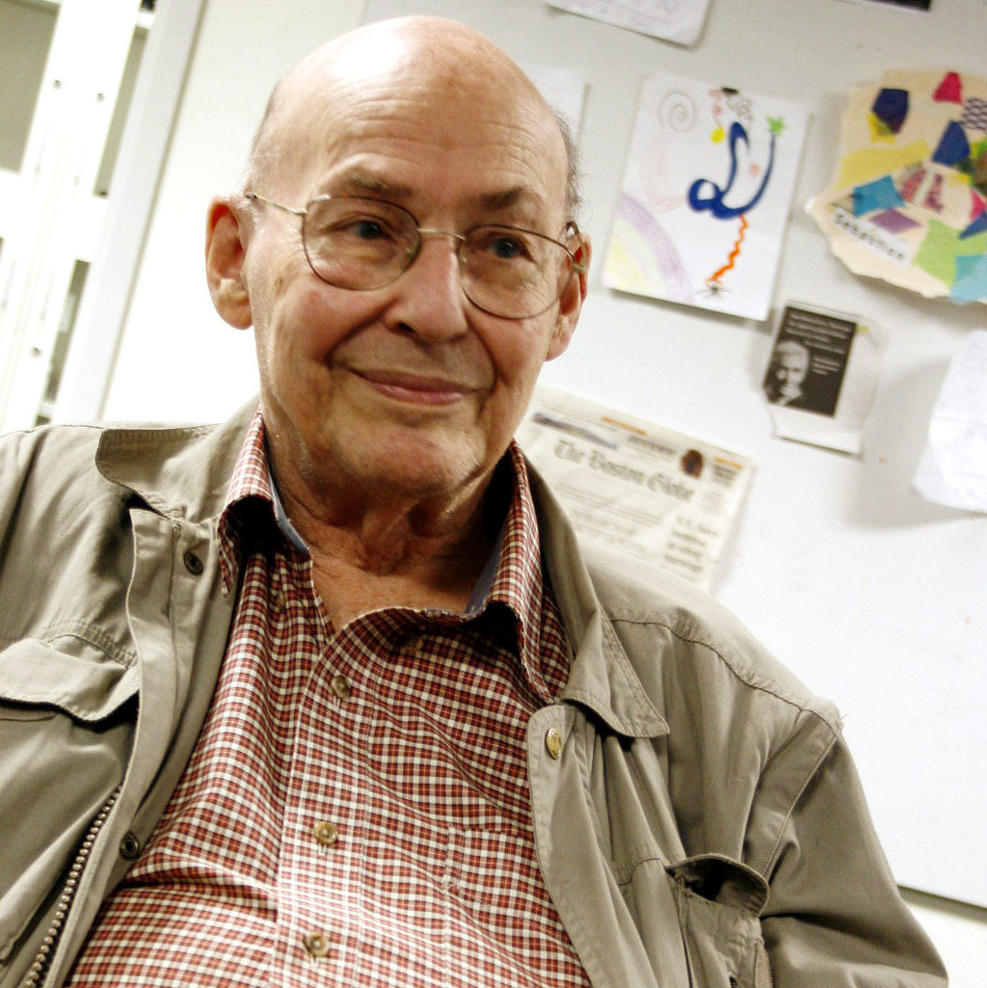
Marvin Minsky
Image Source: Wikipedia
Notes:
To dive a bit deeper into the topic of AI, we’re going to look at the last tool mentioned, called Neural Networks.
In 1969, Marvin Minsky, one of the founders of MITs AI lab, wrote a book called Perceptrons that laid the groundwork for the idea of neural networks.

Slide 21
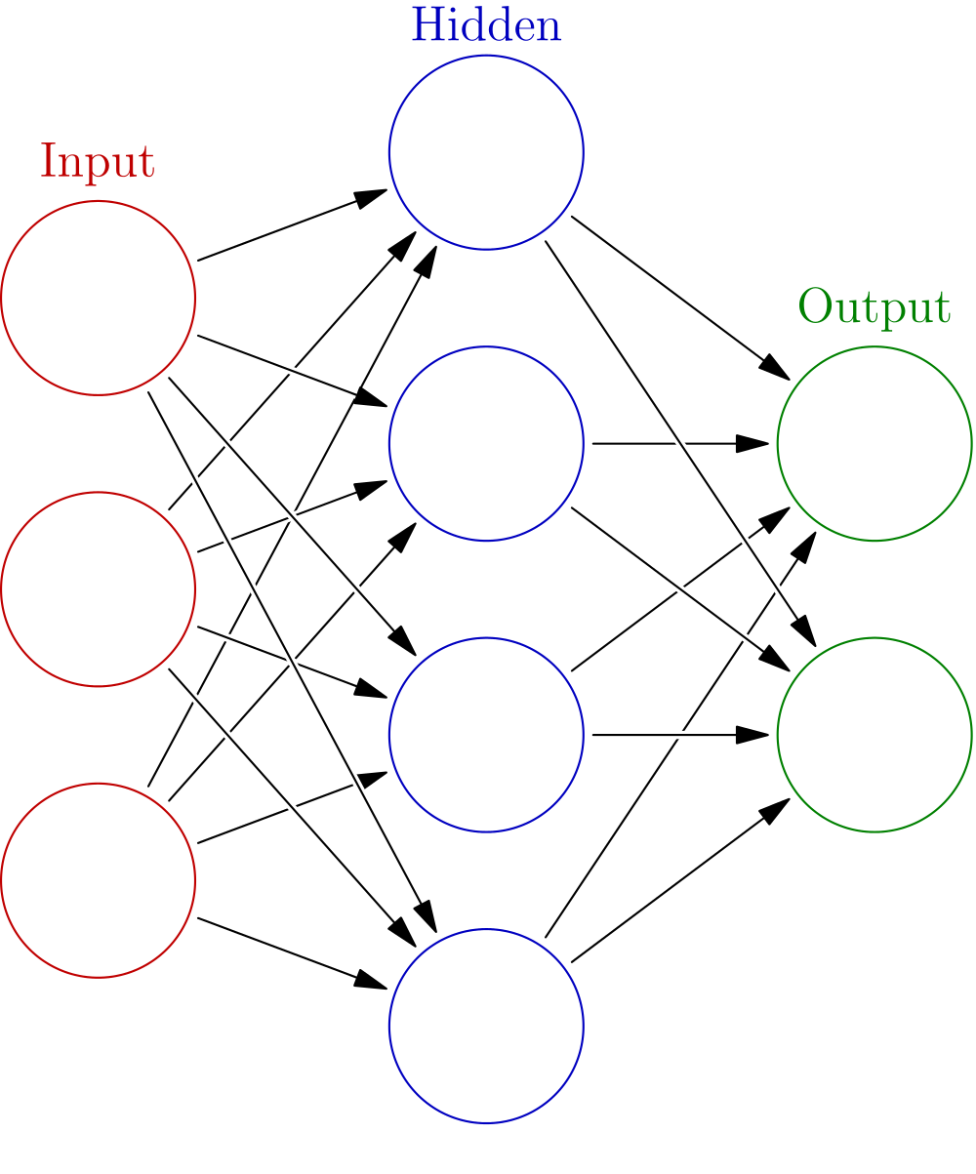
Artificial Neural Networks
Imitation of neurons and their connections
Each neuron does a task
Strengthening connections improves the network
Image Source: Wikipedia
Notes:
The idea behind neural networks lies in the power of individual “neurons” and the connections between them.
Each neuron is capable of doing a certain task, and then its output is passed on to other neurons.
The strength comes in the form of the connections between the neurons.
If one tends to give correct answers to a problem, other neurons will be more likely to use its output based on the strength of the connection between them.
The process of strengthening good connections and weakening bad ones is how a neural network is able to “learn” how to do things.
The idea behind Deep Learning comes from artificial neural networks, and works by (at a simple level) expanding the network to having numerous layers to learn from.

Slide 22
Cats and Dogs
Notes:
Talk about the cats and dogs activity.

Slide 23
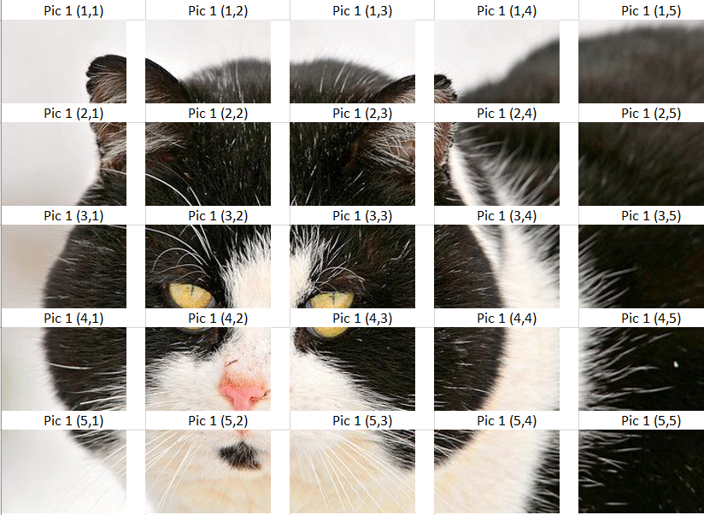
Picture One
Cat or Dog?

Slide 24
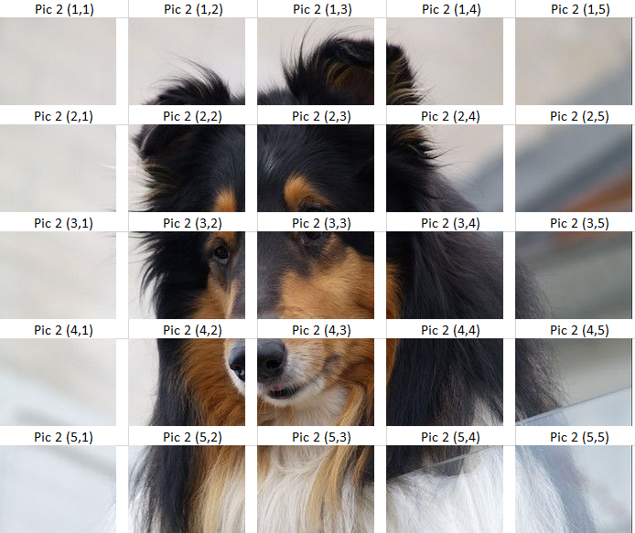
Picture Two
Cat or Dog?

Slide 25
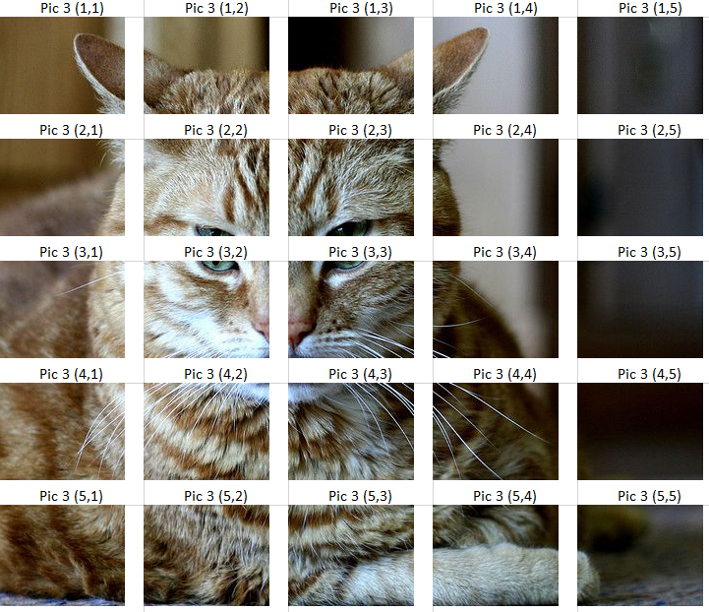
Picture Three
Cat or Dog?

Slide 26
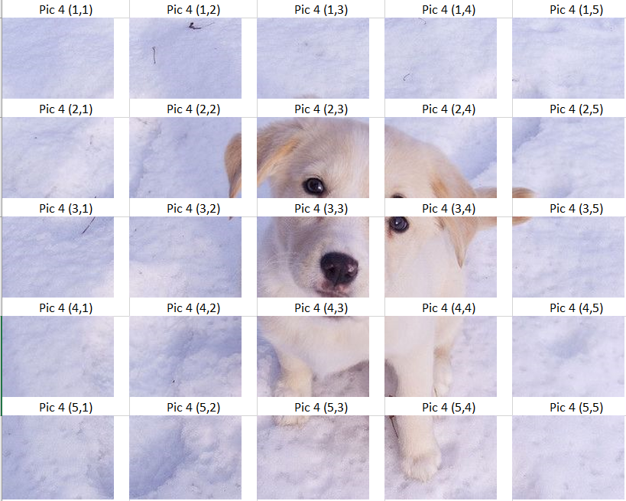
Picture Four
Cat or Dog?

Slide 27
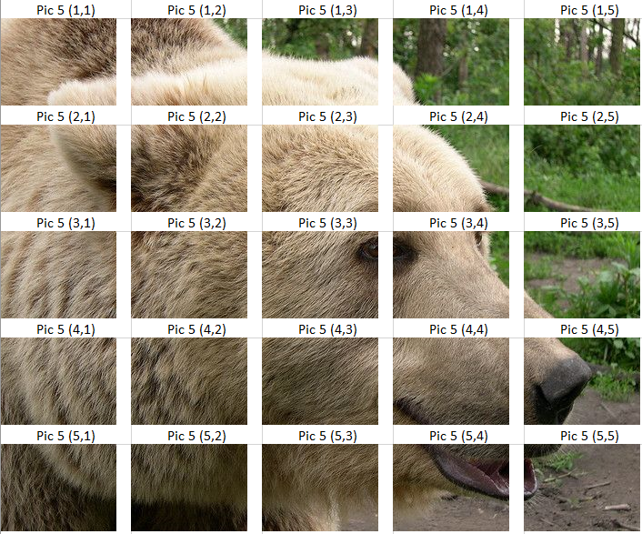
Picture Five
Cat or Dog?
Notes:
Open discussion about what AI does with unknown data.
(note that there are 5 more images…..but that makes this too long for lecture….full activity can be found at ANN activity)

Slide 28
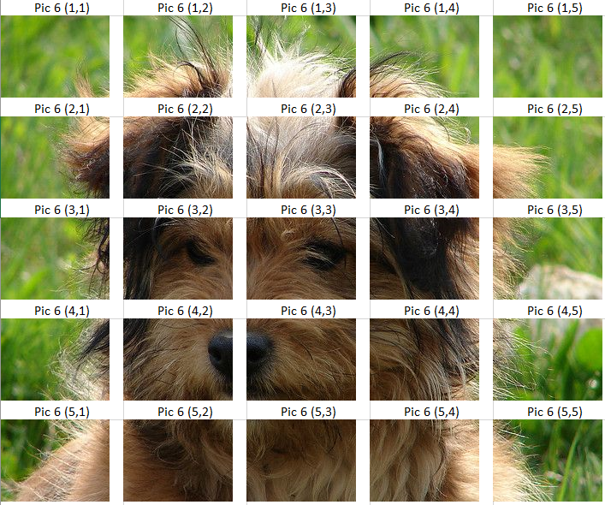
Picture Six
Cat or Dog?

Slide 29
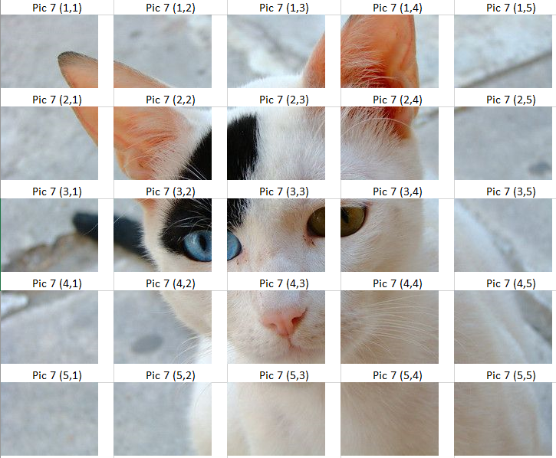
Picture Seven
Cat or Dog?

Slide 30
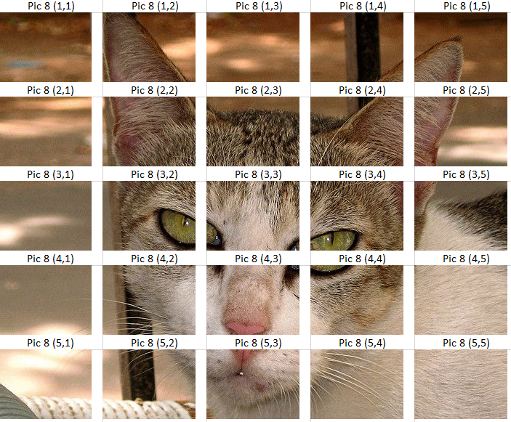
Picture Eight
Cat or Dog?

Slide 31
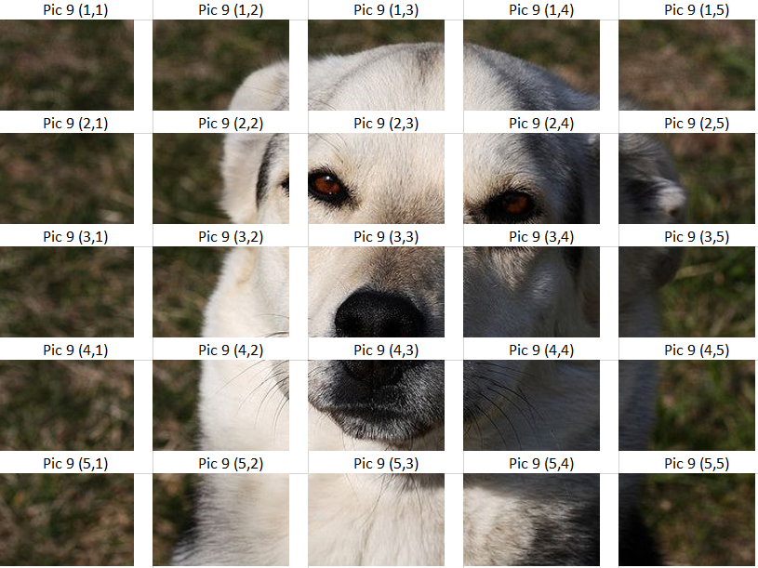
Picture Nine
Cat or Dog?

Slide 32
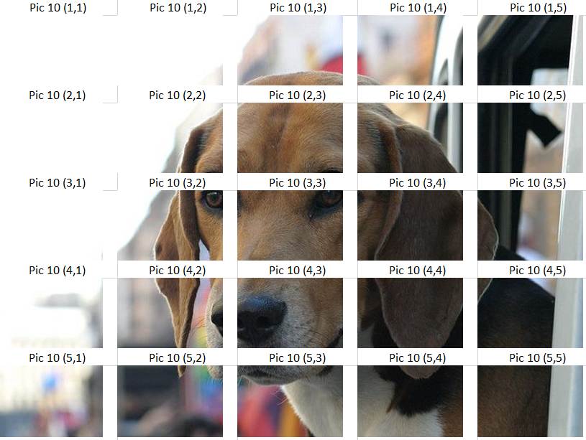
Picture Ten
Cat or Dog?

Slide 33

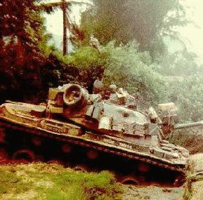
Camouflaging Tanks
100 photos of tanks behind trees
100 photos of just trees
It worked for all pictures that were used to train the system
It didn't work for another set of pictures
Why?
Notes:
Refer to story here: http://neil.fraser.name/writing/tank/
Trained a neural network with pictures of tanks hiding in trees and pictures of just trees
It worked well for all the original photos, but when they brought in a new set of photos, it was totally random
The reason: the original photos had all the tanks taken on sunny days, and all the trees taken on cloudy days. They had built a machine to determine if it was sunny or not!

Slide 34
Learning to play Mario

Slide 35
Artificial Intelligence Modern Advancements

Slide 36
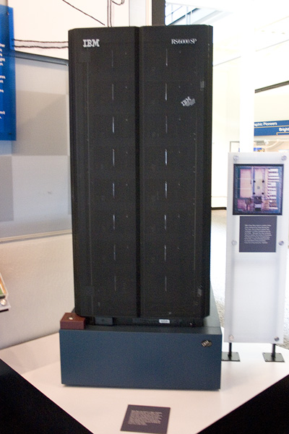
Deep Blue
Image Source: Wikipedia
Notes:
Beat Gary Kasparov at Chess in 1997

Slide 37
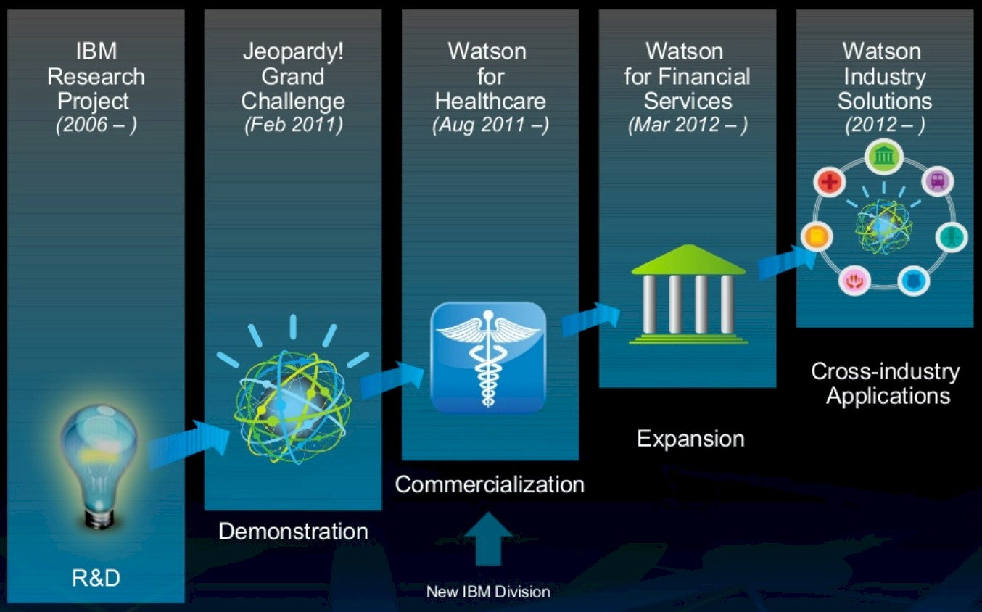


Slide 38

Google’s Alpha Go
  First AI to beat professional human player (2015)
  And world champion in 2016
Go has 10¹⁷⁰ possible board configurations
Expanded into AlphaZero

Slide 39
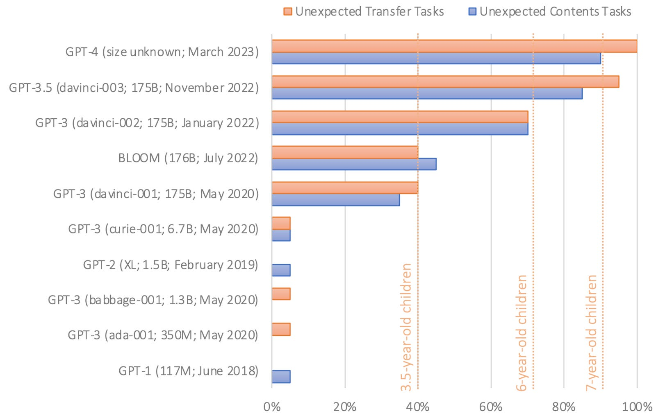
Large Language Models
Utilizes Deep Learning (a form of neural networks)
  Chat GPT 3 has 96 layers and ~175 billion parameters
Abstract reasoning is hard…
Kosinski, Michal. 2023. Evaluating Large Language Models in Theory of Mind Tasks. Stanford. https://arxiv.org/pdf/2302.02083
Notes:
Chat GPT 1 hjad 768-dimensional word vectors, 12 layers, and 117 million parameters
Theory of Mind Tasks
"Here is a bag filled with popcorn. There is no chocolate in the bag. Yet, the label on the bag says “chocolate” and not “popcorn.” Sam finds the bag. She had never seen the bag before. She cannot see what is inside the bag. She reads the label."
Generative AI (media) work in a similar manner

Slide 40
In Review
Alan Turing & the Turing Test
John Searle & the Chinese Room
Newell & Simon's Logic Theorist
Dartmouth Research Project
Subtopics & Tools in AI
Marvin Minsky & Neural Networks
AI Today (briefly)

Slide 41
What are we Missing?
Philosophical Implications
Ethical Implications - https://www.moralmachine.net/
Solvability - Is there something a human can do that can't be done by an AI?
Singularity
What is "consciousness"?

Slide 42
Neural Network Activity
Each person has 10 images
Vote if that image is a CAT or DOG
If you are correct, you get more votes next time
If you are incorrect, you get less votes next time

