Slide 1
CS + X
Or Embedded Computer Science Instruction
Cyber Pipeline Summer Workshop

Slide 2
Computer Science Education:
Then and NoW

Slide 3
Computer Science Education:
Then and NoW

Slide 4
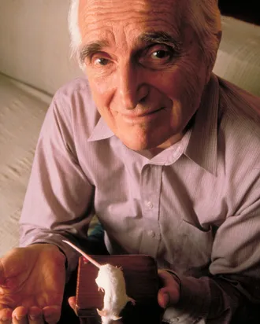
Intellectual Workers
“Technology should not aim to replace humans, rather amplify human capabilities.”
— Doug Engelbart

Slide 5




General Applications

Slide 6
Specialized Applications

Slide 7

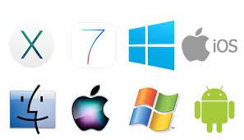
(FIT) Fluency in Information Technology

Slide 8
Computer Science Education:
Then and NoW

Slide 9
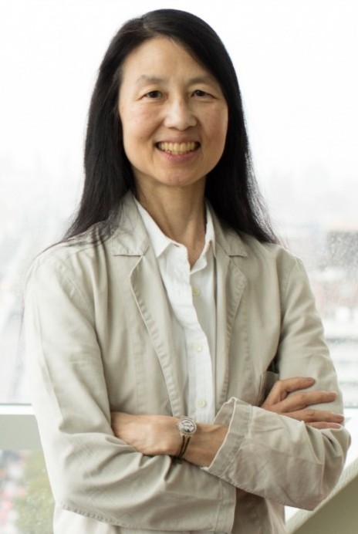
Computational Thinkers
“Computational biology is changing the way biologists think. Similarly, computational game theory is changing the way economists think; nanocomputing, the way chemists think; and quantum computing, the way physicists think.”
— Jeanette Wing

Slide 10
What is Computational Thinking?
“Computational thinking involves solving problems, designing systems, and understanding behavior, by drawing on the concepts fundamental to computer science.”
— Jeanette Wing

Slide 11
ISTE & CSTA Computational Thinking Definition
Computational thinking (CT) is a problem-solving process that includes (but is not limited to) the following characteristics:
Formulating problems in a way that enables us to use a computer and other tools to help solve them
Logically organizing and analyzing data
Representing data through abstractions such as models and simulations
Automating solutions through algorithmic thinking (a series of ordered steps)
Identifying, analyzing, and implementing possible solutions with the goal of achieving the most efficient and effective combination of steps and resources

Slide 12
ISTE & CSTA Computational Thinking Definition
Generalizing and transferring this problem solving process to a wide variety of problems
These skills are supported and enhanced by a number of dispositions or attitudes that are essential dimensions of CT. These dispositions or attitudes include:
Confidence in dealing with complexity
Persistence in working with difficult problems
Tolerance for ambiguity
The ability to deal with open-ended problems
The ability to communicate and work with others to achieve a common goal or solution

Slide 13
What About Programming?

Slide 14
What About Programming?
Lu and Fletcher (2009) have theorized computational thinking to be a foundational skill that underlies student’s ability to write programs – they see the act of writing a program as a formal expression of computational thought.

Slide 15
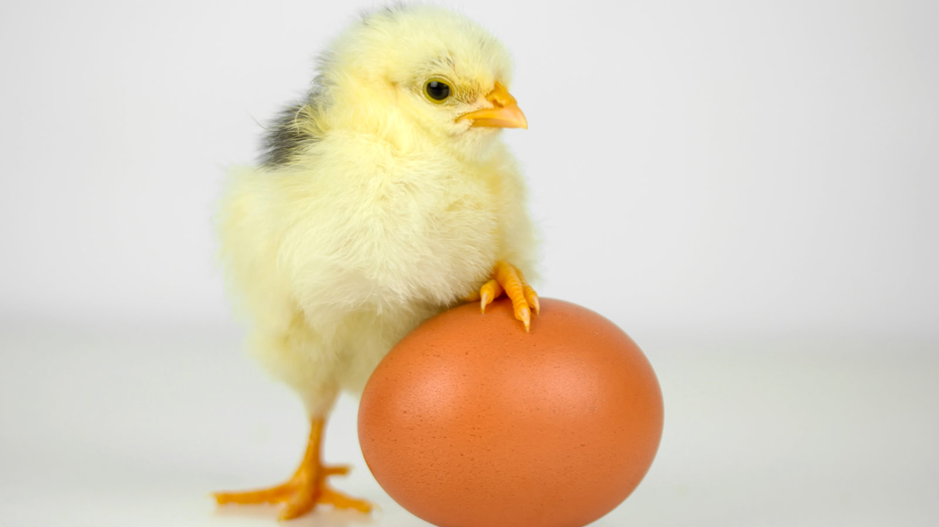
Programming and Computational Thinking

Slide 16
It’s all about problem solving!

Slide 17

The Silo Effect

Slide 18

Transfer of Learning

Slide 19
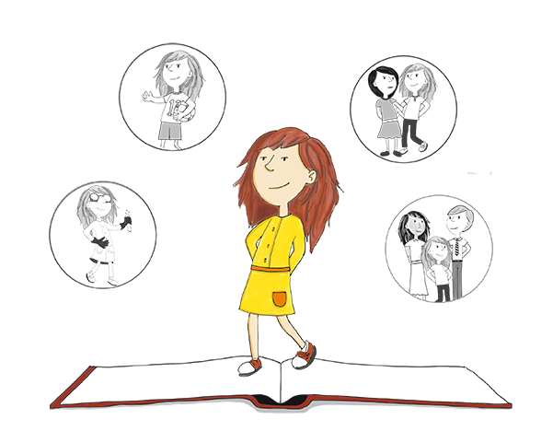
Identity and Motivation

Slide 20
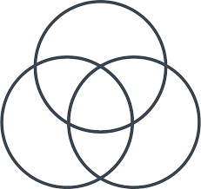
Embedded Computer Science Instruction

Slide 21
Coffee & Bathroom Break

