Slide 1
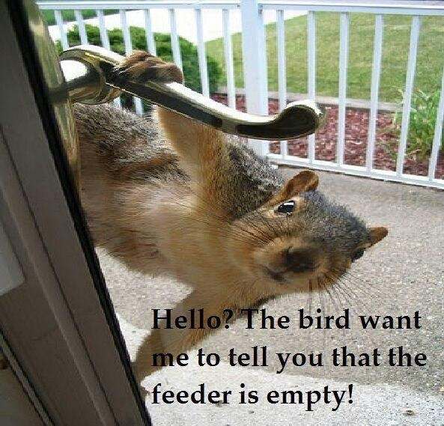
Collaborative Problem Solving: Pie in the Sky or Effective Practice
David S. Allen
Kansas State University

Slide 2
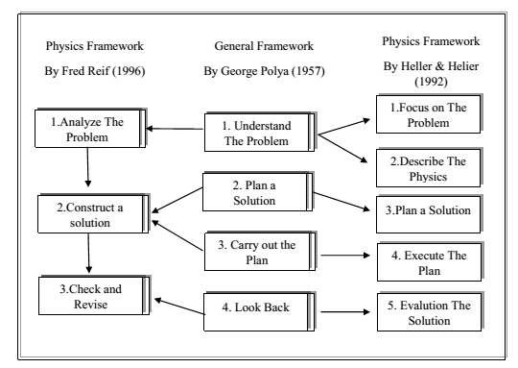
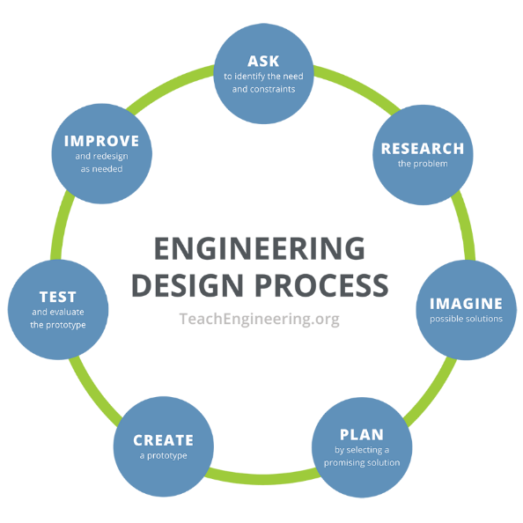
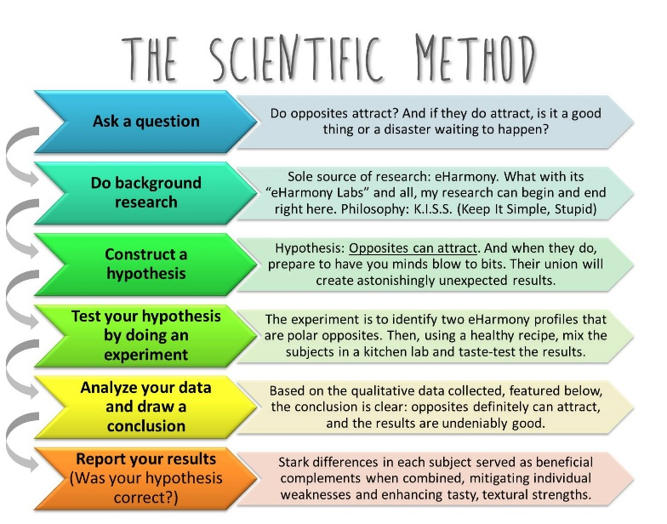
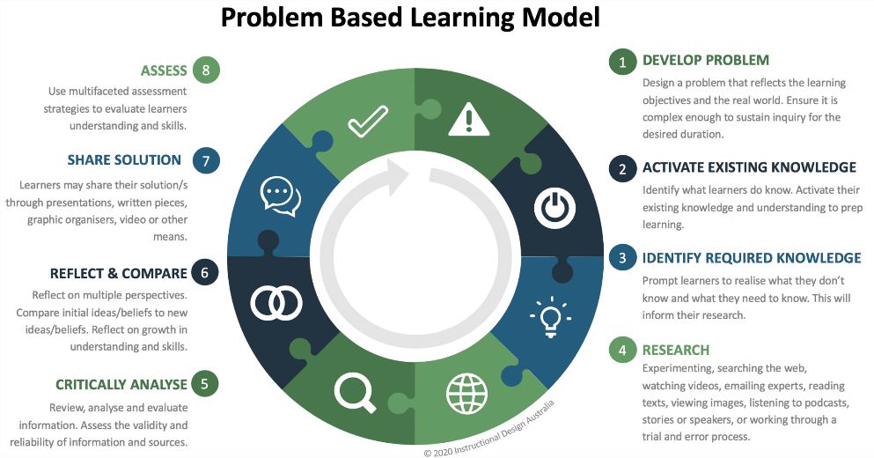
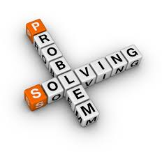
Problem Solving in Context

Slide 3
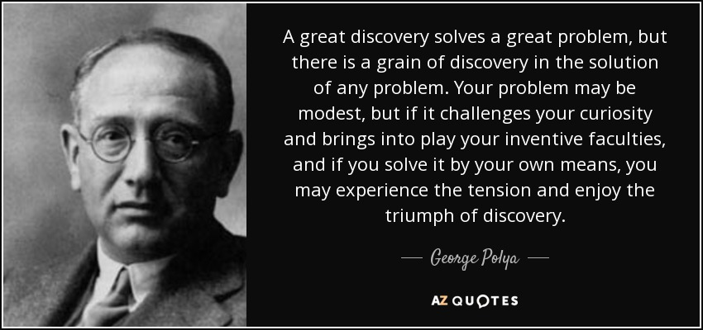
What is Problem Solving?

Slide 4

Getting over the wall!

Slide 5
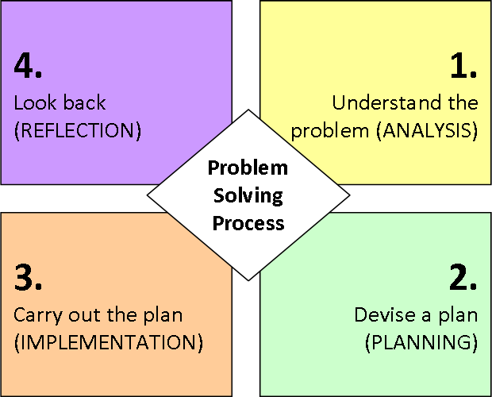
George Polya (1948)

Slide 6


Slide 7
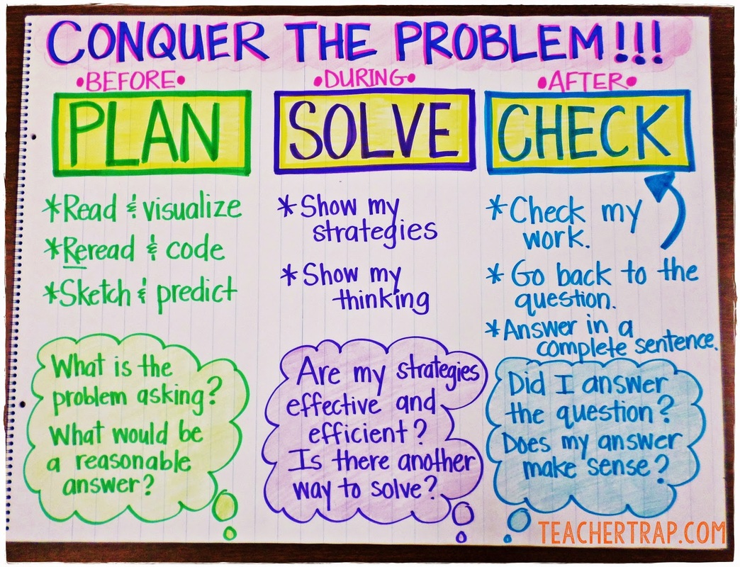

Slide 8
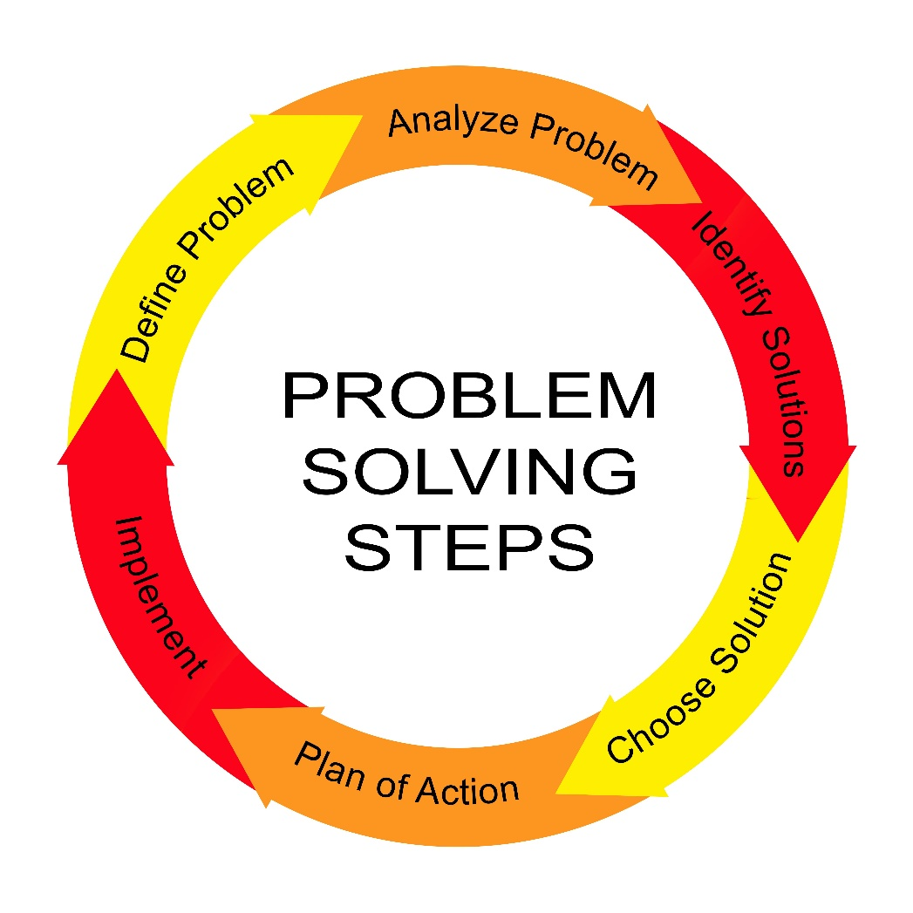

Slide 9
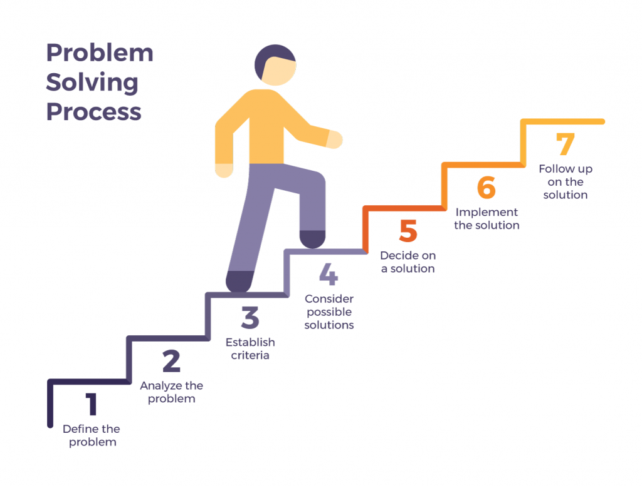

Slide 10
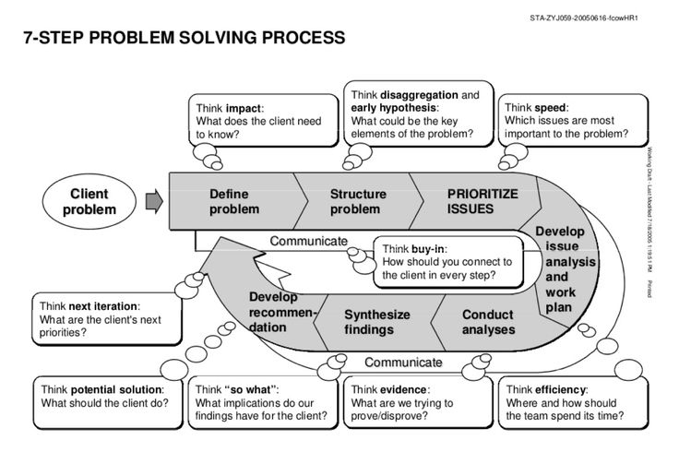

Slide 11
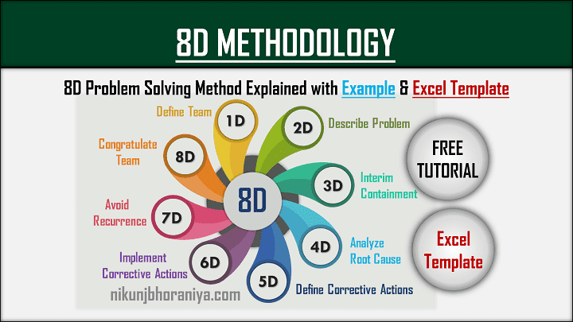

Slide 12
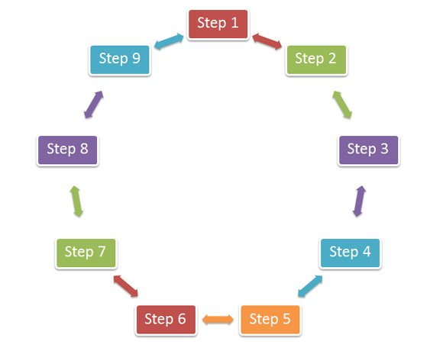

Slide 13
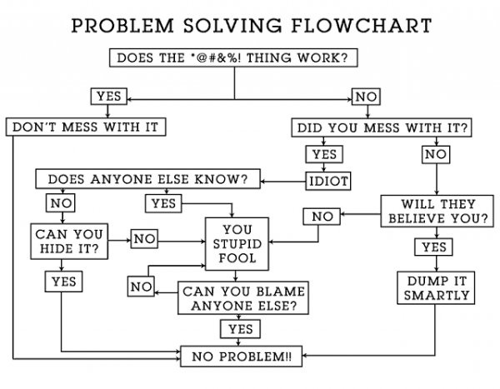

Slide 14


Slide 15
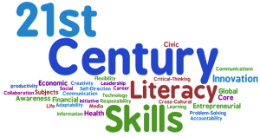

Slide 16
21st Century Skills
Learning
Literacy Skills
Life Skills
Critical Thinking
Creativity
Collaboration
Communication
Information
Media
Technology
Flexibility
Leadership
Initiative
Productivity
Social Skills
Global Awareness

Slide 17
21st Century Skills
Learning
Literacy Skills
Life Skills
Critical Thinking
Creativity
Collaboration
Communication
Information
Media
Technology
Flexibility
Leadership
Initiative
Productivity
Social Skills
Global Awareness

Slide 18
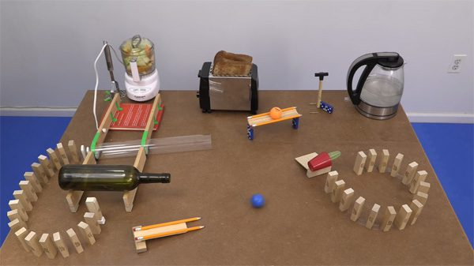
A Rube Goldberg machine, named after American cartoonist Rube Goldberg, is a chain reaction–type machine or contraption intentionally designed to perform a simple task in an indirect and (impractically) overly complicated way. Usually, these machines consist of a series of simple unrelated devices; the action of each triggers the initiation of the next, eventually resulting in achieving a stated goal.

Slide 19
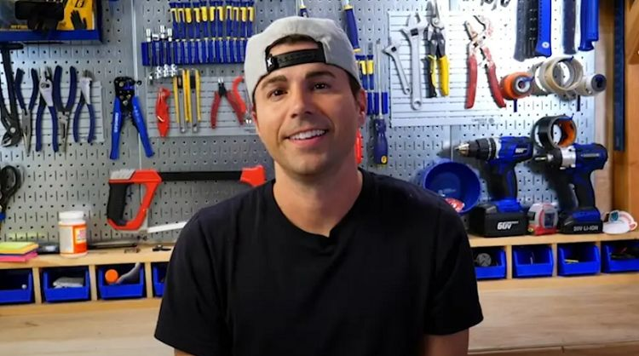
Mark Rober: an American YouTuber, engineer, inventor, and educator. He is known for his YouTube videos on popular science and do-it-yourself gadgets. Before YouTube, Rober was an engineer with NASA for nine years, where he spent seven years working on the Curiosity rover at NASA's Jet Propulsion Laboratory.

Slide 20
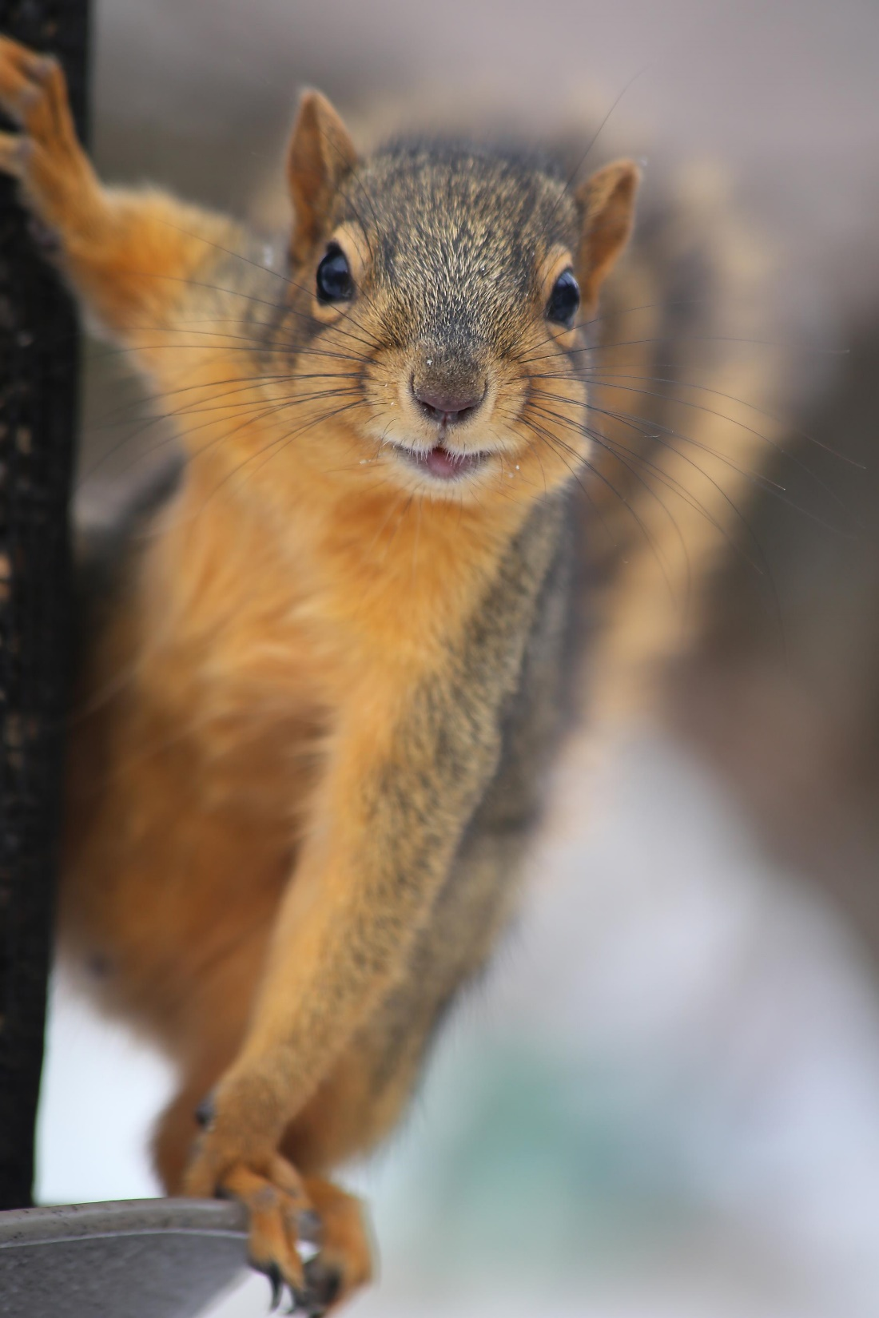
Squirrels have long memory for Problem Solving
"People may try different types of bird feeders to keep the squirrels away, but this research shows grey squirrels can not only remember tricks for getting food but can apply those skills in new situations."

Slide 21
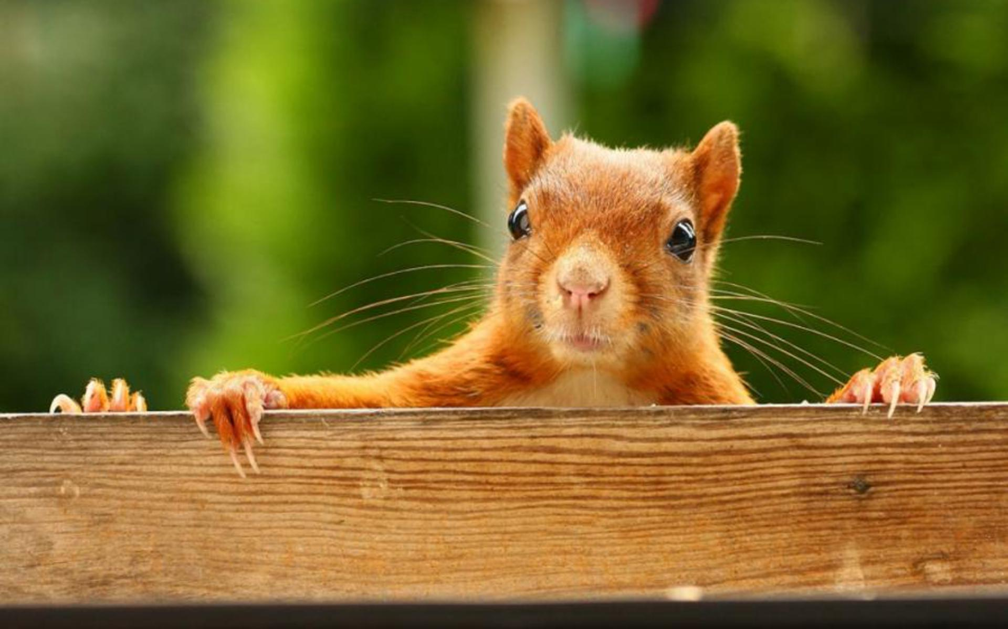
Squirrels have long memory for Problem Solving
Squirrels can remember problem-solving techniques for long periods and can apply them to new situations, researchers have discovered.

Slide 22
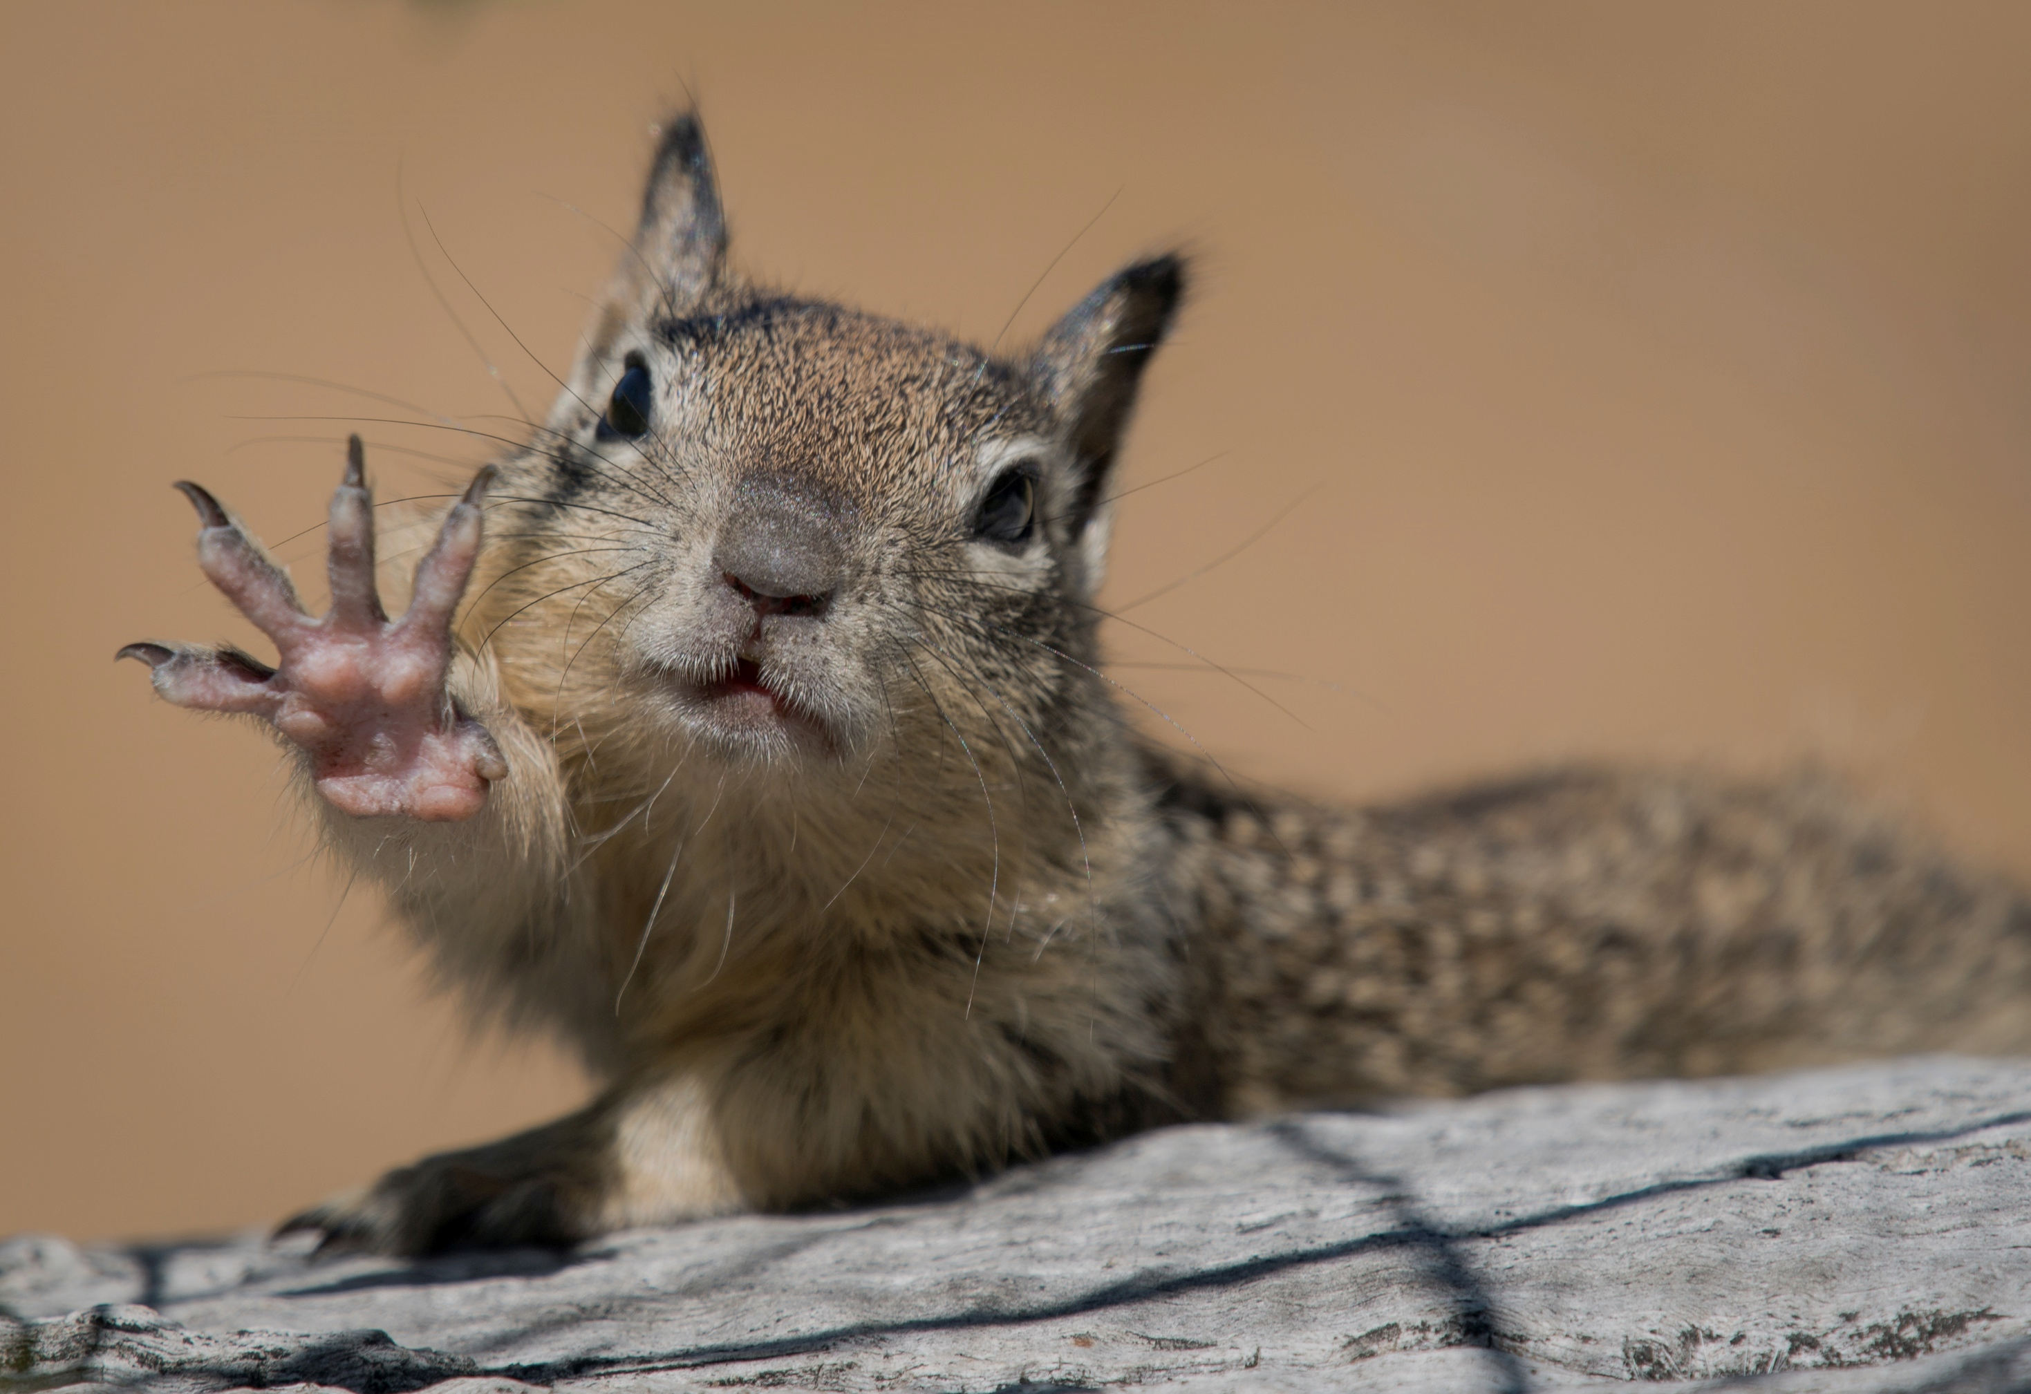
Five Essential Features of Collaborative Learning
Positive interdependence: This means that the task cannot be completed by one person alone. Groups members must synchronize their efforts.
Promotive interaction: Members are willing to support each other to complete the task.
Individually accountable: Students must undertake their share of the work and feel responsible for the group’s success.

Slide 23
Five Essential Features of Collaborative Learning
Interpersonal and group skills need to be developed/supported: We cannot assume students naturally have (or will use) high-level collaboration skills.
Group processing: Members reflect on the quality of their working relationship and seek to improve it through personal and joint effort.

Slide 24
So…uhhhh….what the heck do you want us to do?
Get into self selected groups of 4-5.
Identify your various teaching expertise (math, science, CTE, Business, etc.)
How does problem solving fit into your content area and how often do you incorporate PS into your pedagogy? (I do not mean teaching word problems in a math classroom.)
What difficulties do you encounter when teaching problem solving?
Share your successes and struggles with group problem solving situations in your classroom.
With your group, identify guidelines (at least 5) that you can share with other teacher groups related to successful collaborative problem solving situations.

